Slide 1
Diseases of Stomach
Dr.T.Ajayan

Slide 2
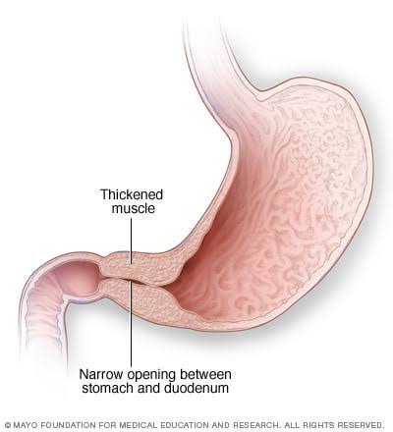
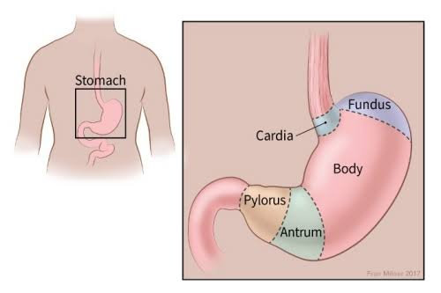
Pyloric Stenosis

Slide 3
Pyloric Stenosis-Congenital
infant 3 to 6 weeks old,
C/F
1.Vomiting, which may be projectile and occasionally
contains bile or blood.
2. Visible peristalsis, usually noticed from left to right side of
the upper abdomen.
3. Palpable lump, better felt after an episode of vomiting.
4. Constipation.
5. Loss of weight.

Slide 4
Pyloric Stenosis-Acquired
Causes
antral gastritis
tumours in the region (gastric carcinoma, lymphoma, pancreatic carcinoma).

Slide 5
Gastritis-Acute
Causes
Spicy foods
Excessive alcohol Consumption
Malnutrition
Viral and Bacterial infection
Drug abuse
Mental stress

Slide 6
Gastritis-Chronic
Causes
Reflux of duodenal contents into the stomach,
Infection with H. pylori is more common
Associated gastric or duodenal ulcer, gastric carcinoma.
Chronic hypochromic anaemia,
Immunological factors such as autoantibodies to gas tric parietal cells or against intrinsic factor.

Slide 7
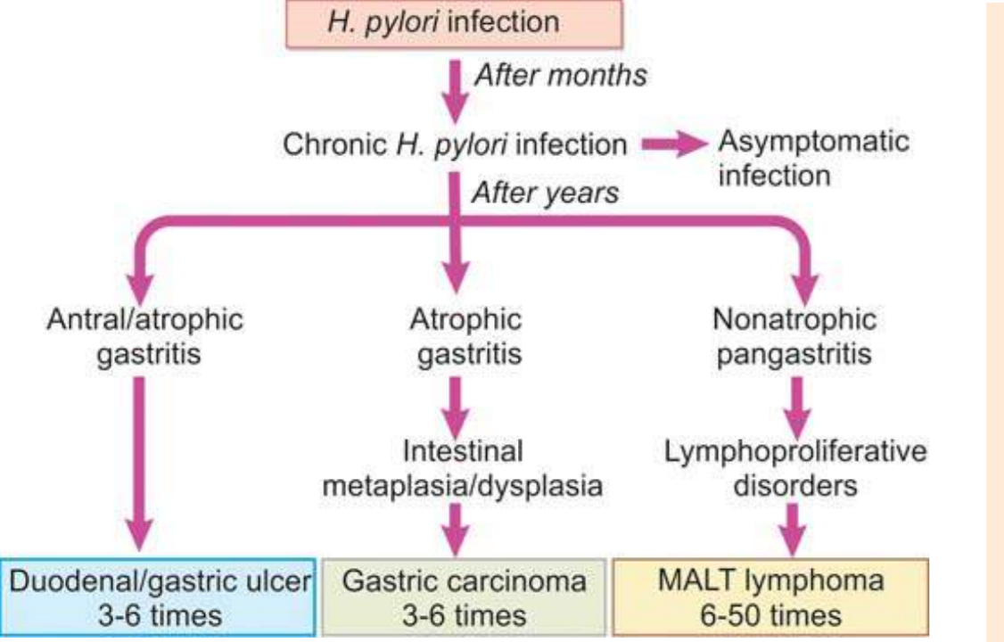
Gastritis-Chronic

Slide 8
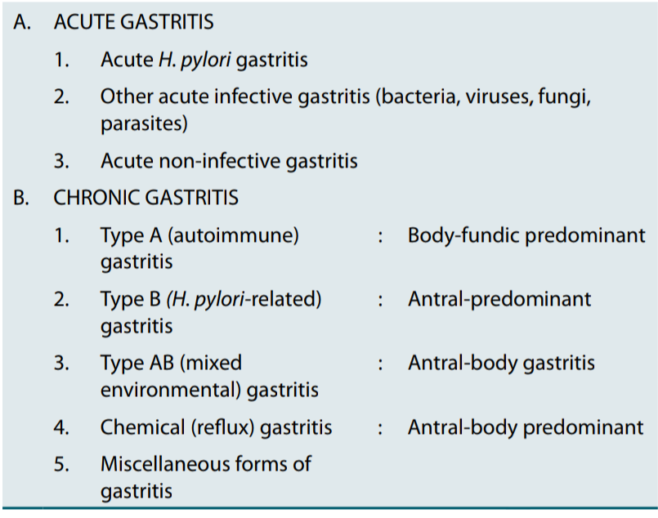
Gastritis

Slide 9
Peptic ulcer
Causes
Psychological stress
2. Physiological stress as in the following:
i) Shock
ii) Severe trauma
iii) Septicaemia
iv) Extensive burns (Curling’s ulcers in the posterior aspect of the fi rst part of the duodenum).
v) Intracranial lesions (Cushing’s ulcers developing from hyperacidity following excessive vagal stimu lation).
vi) Drug intake
vii) Local irritants

Slide 10
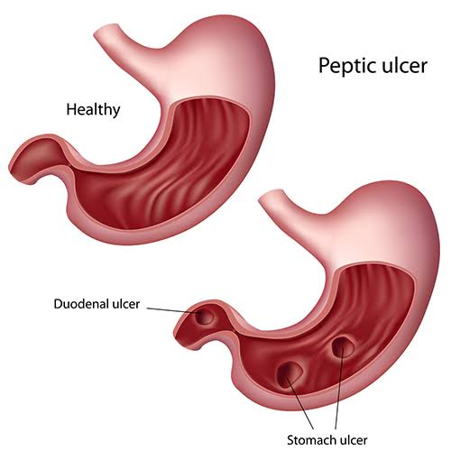
Peptic Ulcer

Slide 11
Peptic Ulcer

Slide 12
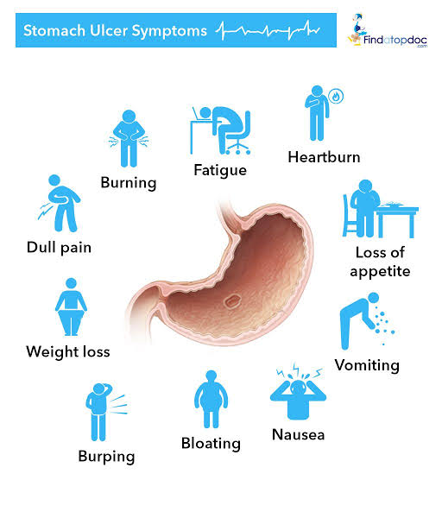

Slide 13
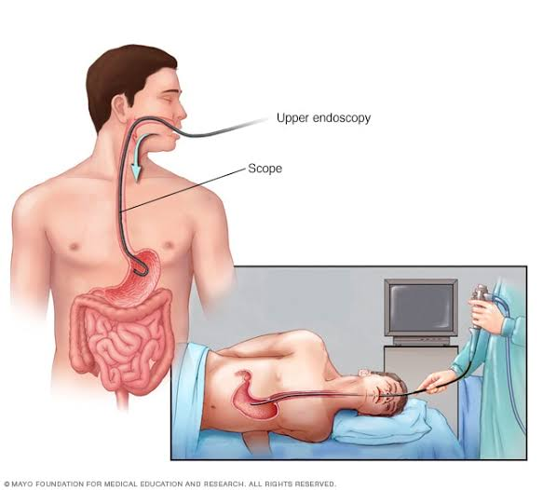
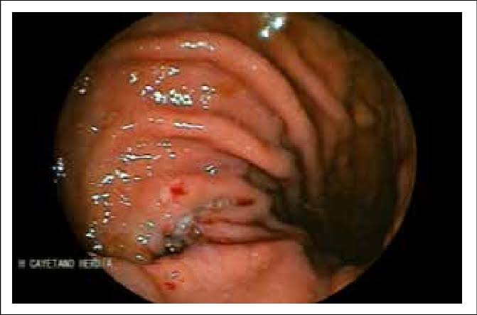
Peptic Ulcer Investigations
Endoscopy is the preferred investigation.
Patients should be screened for H. pylori infection

Slide 14
Peptic ulcer perforation

Slide 15
Gastric Ulcer perforation
Sudden, severe pain, often the first sign of ulcer, starting in the upper abdomen and becoming generalised.
Shoulder tip pain due
shallow respiration due to pain,
● Generalised rigidity. ● Absent bowel sounds. ● Loss of liver dullness

Slide 16
Management of Gastric Perforation
● Nasogastric suction and the administration of large volumes of IV
isotonic saline with potassium.

Slide 18
Gastric Polyps

Slide 19
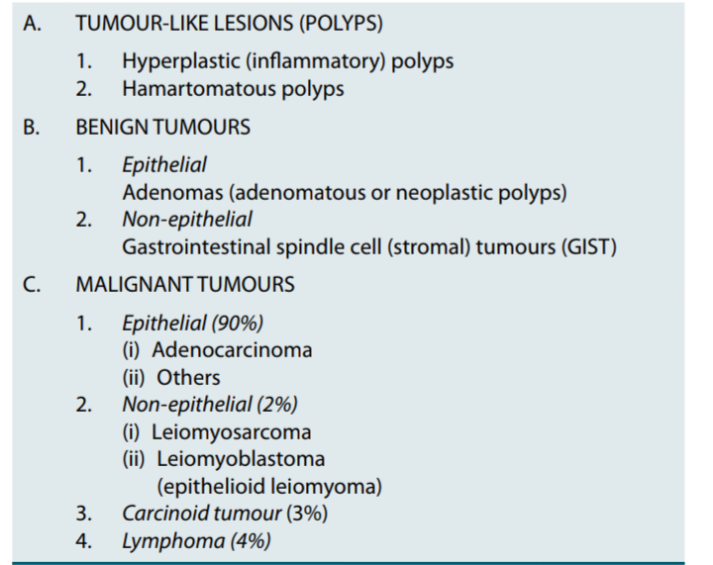
Gastric Cancer

Slide 20
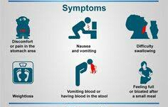
Gastric Cancer Symptoms

Slide 21
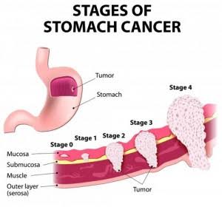

Slide 22
Gastric Cancer Investigation
endoscopy is the investigation of choice
Multiple biopsies from the edge and base of a gastric ulcer are required.

Slide 23
Gastric Cancer Prognosis
Features predicting a favourable prognosis are:
● Stage I or II disease.
● Small, resectable tumours.
● Tumours with low-grade histology
● Age <60 yrs

Slide 24
Thank You All

